Slide 1
RECOMMENDER SYSTEMS
A CASE STUDY ON PRIME VIDEO’s RECOMENDER SYSTEM
LAKKIMSETTI CHARAN
AP22110010443
CSE L

Slide 2
TABLE OF CONTENT
Recommender System
Content Based Filtering
Collaborative Based Filtering
Hybrid Based Filtering
Case Study on Prime Video’s Recommender system
Key Metrix
Result Analysis
Limitations
Conclusion

Slide 3
RECOMMENDER SYSTEMS
A recommender system is an algorithmic framework designed to predict and suggest items (such as products, services, or content) to users based on their preferences, behavior, or demographic information. These systems analyze data from user interactions and item characteristics to provide personalized recommendations, helping users discover relevant items in a large dataset. They are widely used in various applications, including e-commerce, streaming services, social media, and online advertising, to enhance user experience and engagement.
Three types of recommender systems :
Content based filtering
Collaborative Based Filtering
Hybrid Based Filtering

Slide 4
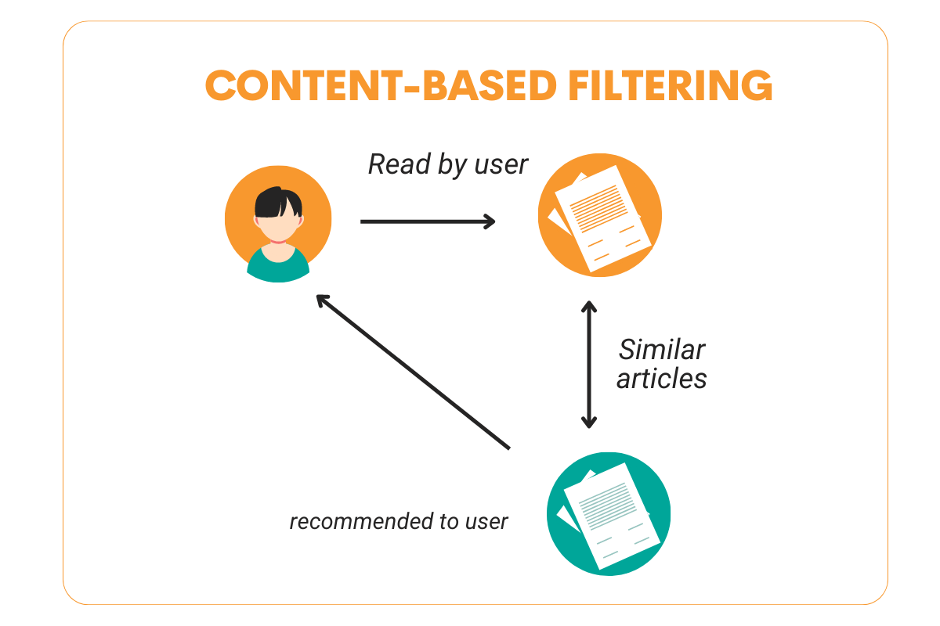
CONTENT BASED FILTERING
Content-based filtering is a recommendation technique that suggests items to users based on the attributes or features of the items themselves and the user's past interactions or preferences. This approach analyzes the characteristics of items (such as genre, keywords, or descriptions) and recommends similar items that align with what the user has previously liked or engaged with. It operates independently of other users' preferences, focusing solely on the relationship between the user's profile and item features. This method is commonly used in applications like movie recommendations, music playlists, and news articles.

Slide 5
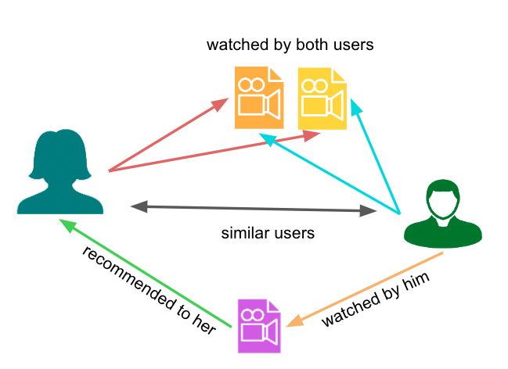
COLLABORATIVE BASED FILTERING
Collaborative filtering is a recommendation technique that suggests items to users based on the preferences and behaviors of other users. It relies on the idea that users who have agreed in the past will continue to agree in the future. There are two main types:
User-Based Collaborative Filtering: This approach finds users who are similar to the target user and recommends items that those similar users have liked.
Item-Based Collaborative Filtering: This method identifies items that are similar to those the user has previously liked, based on the preferences of all users.

Slide 6
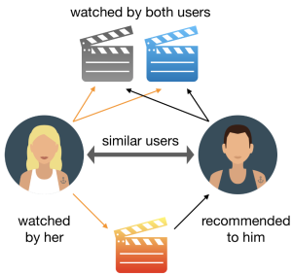
HYBRID FILTERING
Hybrid filtering is a recommendation approach that combines multiple recommendation techniques, typically merging content-based filtering and collaborative filtering. By leveraging the strengths of each method, hybrid systems aim to improve the accuracy and relevance of recommendations while mitigating some of their individual limitations, such as the cold start problem or overfitting.

Slide 7
CASE STUDY ON PRIME Video
CASE STUDY: How Amazon Prime Video Uses Cosine Similarity in Hybrid Filtering for Recommendations
Step 1: Data Preprocessing
Feature Extraction: Amazon Prime Video collects a wide range of user interaction data, such as viewing history, likes, dislikes, and video metadata (genre, director, cast, etc.). This data is used to define user preferences and video attributes, essential for personalized recommendations.
Normalization: Interaction data, like watch time or ratings, is normalized to ensure fair comparisons across different users. This step adjusts for variations in viewing habits, like differing viewing durations, so that recommendations are consistent.
Encoding: Categorical features (e.g., genre, director, actors) are transformed into numerical values using methods like one-hot encoding or embeddings. These embeddings capture complex relationships between users and videos, which enables more accurate recommendation modeling.

Slide 8
Step 2: User-Item Matrix Storage
Matrix Structure: The core data structure is a user-item matrix, where each row represents a user, each column represents a video, and each cell reflects the interaction level between a user and a video (e.g., ratings or watch duration). This matrix is essential for collaborative filtering, allowing the model to detect patterns and relationships between users and videos.
Sparse Data Handling: Because not all users interact with every video, the matrix is typically sparse. To save storage space and improve processing efficiency, only non-zero values (actual interactions) are stored, reducing the matrix’s size and computational load.
Step 3: Cosine Similarity in Hybrid Filtering
Content-Based Filtering: Cosine similarity is applied to video metadata, calculating similarity between videos based on features such as genre, director, and cast. By identifying similar content, Amazon Prime Video can recommend videos that are closely related to what a user has previously watched.

Slide 9
2.Collaborative Filtering: Cosine similarity is calculated on the user-item matrix to identify users with similar viewing habits.
This allows Amazon Prime Video to recommend videos that users with similar preferences have enjoyed,
broadening the viewer’s selection with popular or highly-rated options among like-minded users.
3.Hybrid Approach: Amazon Prime Video combines both content-based and collaborative filtering through a hybrid approach,
which uses a weighting mechanism to balance the two methods. This hybrid model generates a personalized
recommendation list that reflects a user's preferred genres and includes trending videos among similar viewers, enhancing both relevance and diversity in recommendations.

Slide 10
User Engagement & Content Effectiveness Metrics
Watch Time per User Measures total time users spend watching content.
Click-Through Rate (CTR) Percentage of recommended videos clicked on, indicating relevance.
Completion Rate Percentage of videos watched until the end.
Content Diversity Tracks the variety of genres and types consumed, showing balance in recommendations.
Retention Rate Percentage of users who continue using Prime Video over time.

Slide 11
Recommendation Accuracy & Personalization Metrics
1.Precision and Recall Accuracy of recommendations – how many are relevant and useful to the user.
2.Personalization Score Measures how well recommendations are tailored to each user.
3.Subscription Conversion Rate Percentage of trial users who become paid subscribers.
4.Average Revenue per User (ARPU) Revenue generated per user; higher engagement can increase this metric.
5.User Feedback Score Rating of recommended content, indicating user satisfaction.

Slide 12
RESULT ANALYSIS and limitations
Results:
Improved Relevance & Engagement: Cosine similarity enhances recommendation accuracy, boosting click-through rates and watch time by aligning with user preferences.
Balanced Content Discovery: The hybrid approach blends familiar content with new options, increasing diversity without sacrificing personalization.
Efficient & Scalable: Sparse data handling and embedding techniques reduce storage needs and processing time, enabling smooth scaling for large user bases.
Limitations:
Cold Start Challenge: Limited data for new users or content affects initial recommendation accuracy, especially in collaborative filtering.
Computational Load: Real-time updates for a large user base can be resource-intensive, requiring optimized algorithms to maintain speed and efficiency.

Slide 13
Conclusion: Amazon Prime Video’s Hybrid Recommendation System
Amazon Prime Video’s hybrid recommendation system, using cosine similarity, delivers personalized and diverse content by combining content-based and collaborative filtering. This approach enhances user engagement and satisfaction by aligning recommendations with individual preferences while introducing trending options among similar viewers. Efficient sparse data handling supports scalability, though challenges like the cold start problem and computational demands require ongoing optimization. Overall, this system boosts content discovery, retention, and long-term user loyalty, making it a valuable asset in enhancing the viewing experience.

Slide 14


